Slide 1
THE DATABASE LANGUAGE SQL

Slide 2
OBJECTIVES
Understand concepts of
Queries in SQL
Subqueries
Full-relation operations
Database modifications
Transactions in SQL

Slide 3
SIMPLE QUERIES IN SQL

Slide 4
Example Database Schema

Slide 5
SQL Queries and Relational Algebra
Syntax
SELECT L
FROM R
WHERE C_{t}
GROUP BY L_{g}
HAVING C_{g}
ORDER BY L_{o}
π_{L}(T_{Lo}(σ_{Cg}(F_{Lg}(σ_{Ct}(R)))))

Slide 6

Common Query in SQL
Example 1
Listing all employees whose salary exceed at 50000
Input:
Output:
Relation(s):
Joining condition(s):
Selecting condition(s):
Grouping:
Grouping condition(s):
Sorting:
Projecting:
Salary > 50000
tblEmployee
Employee’s information
tblEmployee
tblEmployee
None
empSalary > 50000
None
None
None
* (all information)
Result: 17 rows

Slide 7

Common Query in SQL
Example 2
Listing name and salary of all employees whose income > 50000
Input:
Output:
Relation(s):
Joining condition(s):
Selecting condition(s):
Grouping:
Grouping condition(s):
Sorting:
Projecting:
Salary > 50000
tblEmployee
Employee’s information
tblEmployee
tblEmployee
None
empSalary > 50000
None
None
None
empName, empSalary
Result: 17 rows

Slide 8

Projection in SQL
Using alias name in select clause
Example 3:
Listing full name and salary of all employees whose income exceed 50000

Slide 9
Selection in SQL
Condition expression in where clause may use
Constants and attributes
Arithmetic operators
+, -, *, /
Comparison operators
=, <>, <, >, ≤, ≥
Logical operators
and, or, not
The result of condition must be True or False

Slide 10
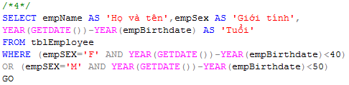
Selection in SQL
Example 4
List all under 40 year-old female or upper 50 year-old male employees

Slide 11
Comparison of Strings
Two strings are equal (=) if they are the same sequence of characters
Other comparisons: <, >, ≤, ≤, ≠
Suppose a=a₁a₂…a_{n} and b=b₁b₂…b_{m} are two strings, the first is less than the second if ∃k≤min(n,m):
∀i, 1≤i≤k: a_{i} = b_{i}, and
a_{k+1}<b_{k+1}
Example
fodder < foo
bar < bargain

Slide 12
Pattern Matching in SQL
Like or Not Like
Two special characters
% means any sequence of 0 or more characters
_ means any one character
SELECT
FROM
WHERE s LIKE p;
SELECT
FROM
WHERE s NOT LIKE p;

Slide 13


Pattern Matching in SQL
Example 5.1:
Find all employees named as ‘Võ Việt Anh’
Example 5.2
Find all employees whose name is ended at ‘Anh’

Slide 14
Dates and Times
Dates and times are special data types in SQL
A date constant’s presentation
DATE ‘1948-05-14’
A time constant’s presentation
TIME ‘15:00:02.5’
A combination of dates and times
TIMESTAMP ‘1948-05-14 12:00:00’
Operations on date and time
Arithmetic operations
Comparison operations

Slide 15
Null Values
Null value: special value in SQL
Some interpretations
Value unknown: there is, but I don’t know what it is
Value inapplicable: there is no value that makes sense here
Value withheld: we are not entitled to know the value that belongs here
Null is not a constant
Two rules for operating upon a NULL value in WHERE clause
Arithmetic operators on NULL values will return a NULL value
Comparisons with NULL values will return UNKNOWN

Slide 16
The Truth-Value UNKNOWN
Condition in WHERE clause produce three truth values: True, False, and Unknown
x | y | x AND y | x OR y | NOT x
True | True | True | True | False
True | Unknown | Unknown | True | False
True | False | False | True | False
Unknown | True | Unknown | True | Unknown
Unknown | Unknown | Unknown | Unknown | Unknown
Unknown | False | False | Unknown | Unknown
False | True | False | True | True
False | Unknown | False | Unknown | True
False | False | False | False | True

Slide 17
The Truth-Value Unknown
SQL conditions in Where clause produce three truth values: True, False, and Unknown
Those tuples which condition has the value True become part of the answer
Those tuples which condition has the value False or Unknown are excluded from the answer

Slide 18
Ordering the Output
Presenting the tuples produced by a query in sorted order
The order may be based on the value of any attribute
Syntax
Order by clause follows Where and any other clauses
The ordering is performed on the result of the From, Where, and other clauses, just before Select clause
SELECT <list of attributes>
FROM <list of tables>
WHERE <conditions>
ORDER BY <list of attributes>

Slide 19

Ordering the Output
Example 6
Listing all employee by department number ascreasingly, then by salary descreasingly
Input:
Output:
Relation(s):
Joining condition(s):
Selecting condition(s):
Grouping:
Grouping condition(s):
Sorting:
Projecting:
None
Employee’s information
tblEmployee
tblEmployee
None
None
None
None
Result: 21 rows
depNum ASC, empSalary DESC
* (all information)

Slide 20
QUERIES INVOLVING MORE THAN ONE RELATION

Slide 21
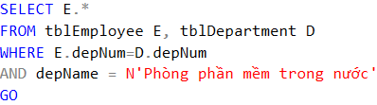
Products and Joins in SQL
Example 7
List all employees who work on ‘Phòng Phần mềm trong nước’ department
Input:
Output:
Relation(s):
Joining condition(s):
Selecting condition(s):
Grouping:
Grouping condition(s):
Sorting:
Projecting:
Dname = ‘Phòng Phần mềm trong nước’
tblDepartment
Employee’s information
tblEmployee
tblEmployee E, tblDepartment D
E.depNum = D.depNum
Dname = N‘Phòng Phần mềm trong nước’
None
None
None
E.* (all information)
Result: 5 rows

Slide 22
Products and Joins in SQL
Compare two above queries
Tuple variables for
ambiguous occurences
SELECT E.*
FROM tblEmployee E, tblDepartment D
WHERE E.depNum=D.depNum
AND depName = N'Phòng phần mềm trong nước'
GO
SELECT *
FROM tblEmployee, tblDepartment
WHERE depNum=depNum
AND depName = N'Phòng phần mềm trong nước'
GO

Slide 23

Products and Joins in SQL
Example 8:
Find all cities in which our company is

Slide 24

Products and Joins in SQL
Example 9:
Find all employees who work on projectB

Slide 25
Union, Intersection, Difference of Queries
We combine relations using the set operations of relational algebra: union, intersection, and difference
SQL provides corresponding operators with UNION, INTERSECT, and EXCEPT for ∪, ∩, and -, respectively

Slide 26

Union, Intersection, Difference of Queries
Example 10.1
Find all those employees whose name is begun by ‘H’ or salary exceed 80000
Name
is begun
by ‘H’
Salary
exceed
80000

Slide 27

Union, Intersection, Difference of Queries
Example 10.2
Find all those normal employees, that is who do not supervise any other employees
All employees
Supervisors

Slide 28
Union, Intersection, Difference of Queries
Example 10.3
Find all employees who work on projectB and projectC
Workers on
ProjectB
Workers on
ProjectC

Slide 29
SUB QUERIES

Slide 30
Sub-queries
One query can be used to help in the evaluation of another
A query that is part of another is called a sub-query
Sub-queries return a single constant, this constant can be compared with another value in a WHERE clause
Sub-queries return relations, that can be used in WHERE clause
Sub-queries can appear in FROM clauses, followed by a tuple variable

Slide 31
Sub-queries that Produce Scalar Values
An atomic value that can appear as one component of a tuple is referred to as a scalar
Let’s compare two queries for the same request

Slide 32
Sub-queries that Produce Scalar Values
Example 7: Find the employees of Phòng Phần mềm trong nước department
SELECT depNum
FROM tblDepartment
WHERE depName=N‘…'
Note:
Output: Information from tblEmployee ONLY
tblDepartment is accessed in one clause ONLY
Suggestion:
tblDepartment may not be used in subquery in its corresponding clause

Slide 33
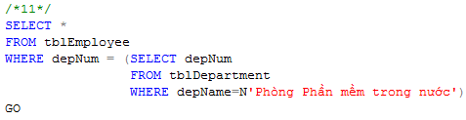
Sub-queries that Produce Scalar Values
Example 11: Find the employees of Phòng Phần mềm trong nước department
SELECT depNum
FROM tblDepartment
WHERE depName=N‘…'

Slide 34
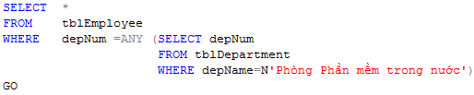
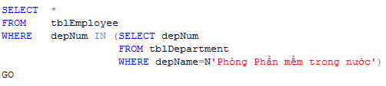
Sub-queries that Produce Scalar Values

Slide 35
Conditions Involving Relations
Some SQL operators can be applied to a relation R and produce a bool result
(EXISTS R = True) ⇔ R is not empty
(s IN R = True) ⇔ s is equal to one of the values of R
(s > ALL R = True) ⇔ s is greater than every values in unary R
(s > ANY R = True) ⇔ s is greater than at least one value in unary R

Slide 36
Conditions Involving Tuples
A tuple in SQL is represented by a list of scalar values between ()
If a tuple t has the same number of components as a relation R, then we may compare t and R with IN, ANY, ALL

Slide 37
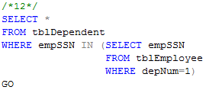
Sub-queries that Produce Scalar Values
Example 12:
Find the dependents of all employees of department number 1

Slide 38
Correlated Sub-queries
To now, sub-queries can be evaluated once and for all, the result used in a higher-level query
But, some sub-queries are required to be evaluated many times
That kind of sub-queries is called correlated sub-query
Note: Scoping rules for names

Slide 39
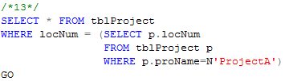
Correlated Sub-queries
Example 13:
Find all those projects have the same location with projectA

Slide 40
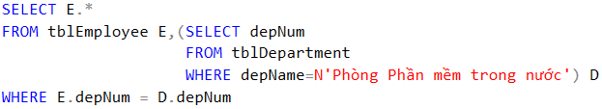
Sub-queries in FROM Clauses
In a FROM list we can use a parenthesized sub-query
We must give it a tuple-variable alias
Example 14: Find the employees of Phòng Phần mềm trong nước

Slide 41
SQL Join Expressions
SQL Join Expressions can be stand as a query itself or can be used as sub-queries in FROM clauses
Cross Join in SQL= Cartesian Product
Syntax: R CROSS JOIN S;
Meaning: Each tuple of R connects to each tuple of S
Theta Join with ON keyword
Systax: R JOIN S ON R.A=S.A;
Meaning: Each tuple of R connects to those tuples of S, which satisfy the condition after ON keyword

Slide 42


SQL Join Expression
Example 15.1
Product two relations Department and Employee
Example 15.2
Find departments and employees who work in those departments, respectively (~21 tuples)

Slide 43
Natural Joins
A natural join differs from a theta-join in that:
The join condition: all pairs of attributes from the two relations having a common name are equated, and there are no other condition
One of each pair of equated attributes is projected out

Slide 44
Natural Joins
Example 16:
Find all locations in which projects are processing
(MSSQL SERVER DONOT SUPPORT NATURAL JOINS AT ALL)

Slide 45
Outer Joins
The outer join is a way to augment the result of join by the dangling tuples, padded with null values
When padding dangling tuples from both of its arguments, we use full outer join
When padding from left/right side, we use left outer join/right outer join

Slide 46

Outer joins
Example 17.1:
For each location, listing the projects that are processed in it

Slide 47

Outer joins
Example 17.2:
For each department, listing the projects that it controls

Slide 48
Eliminating Duplicates
A relation, being a set, cannot have more than one copy of any given tuple
But, the SQL response to a query may list the same tuple several times, that is, SELECT preserves duplicates as a default
So, by DISTINCT we can eliminate a duplicates from SQL relations

Slide 49
Eliminating Duplicates
Example 8.1: List all location in which the projects are processed.
Location name is repeated many times

Slide 50
Duplicates in Unions, Intersections, and Differences
Set operations on relations will eliminate duplicates automatically
Use ALL keyword after Union, Intersect, and Except to prevent elimination of duplicates
Syntax:
R UNION ALL S;
R INTERSECT ALL S;
R EXCEPT ALL S;

Slide 51
Grouping and Aggregation in SQL
Grouping operator partitions the tuples of relation into groups, based on the values of tuples in one or more attributes
After grouping the tuples of relation, we are able to aggregate certain other columns of relation
We use GROUP BY clause in SELECT statement

Slide 52
Aggregation Operators
Five aggregation operators
SUM acts on single numeric column
AVG acts on single numeric column
MIN acts on single numeric column
MAX acts on single numeric column
COUNT act on one or more columns or all of columns
Eliminating duplicates from the column before applying the aggregation by DISTINCT keyword

Slide 53


Aggregation Operators
Example 18.1
Find average salary of all employees
Example 18.2
Find number of employees

Slide 54
Grouping
To partition the tuples of relation into groups
Syntax
SELECT <list of attributes>
FROM <list of tables>
WHERE <condition>
GROUP BY <list of attributes>

Slide 55
Grouping
There are two kinds of terms in SELECT clause
Aggregations, that applied to an attribute or expression involving attributes
Attributes, that appear in GROUP BY clause
A query with GROUP BY is interpreted as follow:
Evaluate the relation R expressed by the FROM and WHERE clauses
Group the tuples of R according to the attributes in GROUP BY clause
Produce as a result the attributes and aggregation of the SELECT clause

Slide 56
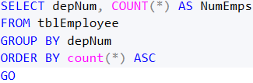
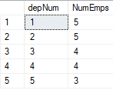
Grouping
Example 19.2
List number of employees for each department number
Input:
Output:
Relation(s):
Joining condition(s):
Selecting condition(s):
Grouping:
Grouping condition(s):
Sorting:
Projecting:
None
depNum, number of Employees
tblEmployee
tblEmployee
None
None
depNum
None
None
depNum, count(*)

Slide 57

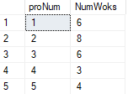
Grouping
Example 20
Compute the number of workers for each project
Input:
Output:
Relation(s):
Joining condition(s):
Selecting condition(s):
Grouping:
Grouping condition(s):
Sorting:
Projecting:
None
proNum, number of workers
tblWorksOn
tblWorksOn
None
None
proNum
None
None
proNum, count(*)

Slide 58
Grouping, Aggregation, and Nulls
When tuples have nulls, there are some rules:
The value NULL is ignored in any aggregation
Count(*): a number of tuples in a relation
Count(A): a number of tuples with non-NULL values for A attribute
NULL is treated as an ordinary value when forming groups
The count of empty bag is 0, other aggregation of empty bag is NULL

Slide 59
Grouping, Aggregation, and Nulls
Example: Suppose R(A,B) as followed
A | B
NULL | NULL
The result of query
SELECT A, count(B)
FROM R
GROUP BY A;
is one tuple (NULL,0)
The result of query
SELECT A, sum(B)
FROM R
GROUP BY A;
is one tuple (NULL,NULL)

Slide 60
Considerations …
If we want to apply conditions to tuples of relations, we put those conditions in WHERE clause
If we want to apply conditions to groups of tuples after grouping, those conditions are based on some aggregations, how can we do?
In that case, we follow the GROUP BY clause with a HAVING clause

Slide 61
HAVING clause
Syntax:
SELECT <list of attributes>
FROM <list of tables>
WHERE <conditions on tuples>
GROUP BY <list of attributes>
HAVING <conditions on groups>

Slide 62
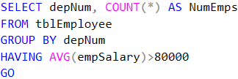

Grouping
Example 21
Print the number of employees for each those department, whose average salary exceeds 80000
Input:
Output:
Relation(s):
Joining condition(s):
Selecting condition(s):
Grouping:
Grouping condition(s):
Sorting:
Projecting:
Avg. salary > 80000
tblEmployee
depNum, number of employees
tblEmployee
tblEmployee
None
None
depNum
AVG(empSalary) > 80000
None
depNum, count(*)

Slide 63
HAVING clause
Some rules about HAVING clause
An aggregation in a HAVING clause applies only to the tuples of the group being tested
Any attribute of relations in the FROM clause may be aggregated in the HAVING clause, but only those attributes that are in the GROUP BY list may appear un-aggregated in the HAVING clause (the same rule as for the SELECT clause)

Slide 64
Exercises
Display number of projects for each employee
Required information
Employee’s name, number of projects
Display number of dependents for each employee
Required information
Employee’s name, number of projects
Display name of employees, who works on more than 2 projects
Required information
Employee’s name, his department’s name, number of projects

Slide 65
DATABASE MODIFICATIONS

Slide 66
Database Modifications
Three types of statements that allow us to
Insert tuples into relation
Delete certain tuples from a relation
Update values of certain components of certain existing tuples

Slide 67
Insertion
Basic form of insertion statement
A tuple is created using the values v₁ for attribute A_{i}
If the list of attributes does not include all attributes of the relation R, then the tuple created has default values for all missing attributes
The basic form allows to insert only one tuple at once
The extended form allows to insert a set of tuples as result of a sub query
INSERT INTO R(A1,…,An) VALUES (v₁ ,…,v_{n} );

Slide 68

Insertion
Example

Slide 69
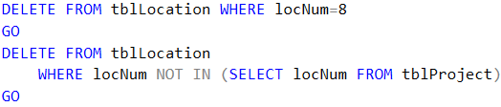
Deletion
The form of a deletion
All tuples are removed from table R, which are satisfied the deleting condition
Subqueries may be used in deleting condition
Example
DELETE FROM R WHERE <condition>;

Slide 70
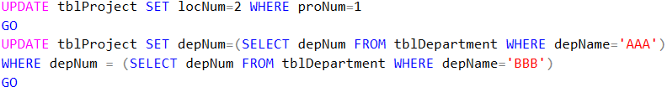
Updates
The form of an update statement
Those tuples are modified as required in SET clause, which are satisfied the updating condition
Subqueries may be use in SET and/or WHERE clause
Example
UPDATE R SET <new-value assignments>
WHERE <condition>

Slide 71
TRANSACTION IN SQL

Slide 72
Introduction
DB User operates on database by querying or modifying the database
Operations on database are executed one at a time
Output of one operation is input of the next operation
So, how the DBMS treats simultaneous operations?

Slide 73
Serializability
In applications, many operations per second may be performed on database
These may operate on the same data
We’ll get unexpected results

Slide 74
Serializability
Example

Slide 75
Serializability
Transaction is a group of operations that need to be performed together
A certain transaction must be serializable with respect to other transactions, that is, the transactions run serially – one at a time, no overlap

Slide 76
Atomicity
A certain combinations of database operations need to be done atomically, that is, either they are both done or neither is done

Slide 77
Atomicity
Example: Transfer $100 from the account number 123 to account number 456 by two steps
(1) Add $100 to account number 456
(2) Subtract $100 from account number 123
What happen if there is a failure after step (1) but before step (2)?

Slide 78
Transactions
Transaction is a collection of one or more operations on the database that must be executed atomically
That is, either all operations are performed or none are
In SQL, each statement is a transaction by itself
SQL allows to group several statements into a single transaction

Slide 79
Transactions
Transaction begins by SQL command START TRANSACTION
Two ways to end a transaction
The SQL statement COMMIT causes the transaction to end successfully
The SQL statement ROLLBACK causes the transaction to abort, or terminate unsuccessfully

Slide 80
Read-Only Transactions
A transaction can read or write some data into the database
When a transaction only reads data and does not write data, the transaction may execute in parallel with other transactions
Many read-only transactions access the same data to run in parallel, while they would not be allowed to run in parallel with a transaction that wrote the same data

Slide 81
Transactions
SQL statement set read-only to the next transaction
SET TRANSACTION READ ONLY;
SQL statement set read/write to the next transaction
SET TRANSACTION READ WRITE;

Slide 82
Dirty Reads
Dirty data: data written by a transaction that has not yet committed
Dirty read: read of dirty data written by another transaction
Problem: the transaction that wrote it may eventually abort, and the dirty data will be removed
Sometimes the dirty read matters, sometimes it doesn’t

Slide 83
Dirty Reads
We can specify that dirty reads are acceptable for a given transaction
SET TRANSACTION READ WRITE
ISOLATION LEVEL READ UNCOMMITTED;

Slide 84
Other Isolation Levels
SET TRANSACTION ISOLATION LEVEL READ UNCOMMITED;
SET TRANSACTION ISOLATION LEVEL READ COMMITTED;
SET TRANSACTION ISOLATION LEVEL REPEATABLE READ;
SET TRANSACTION ISOLATION LEVEL SERIALIZABLE;

Slide 85
Listing all those employees who are going to be retired in this year.
Listing all those departments in which the average of salary is maximum.
Listing the number of projects for each department (if any).

